Slide 1


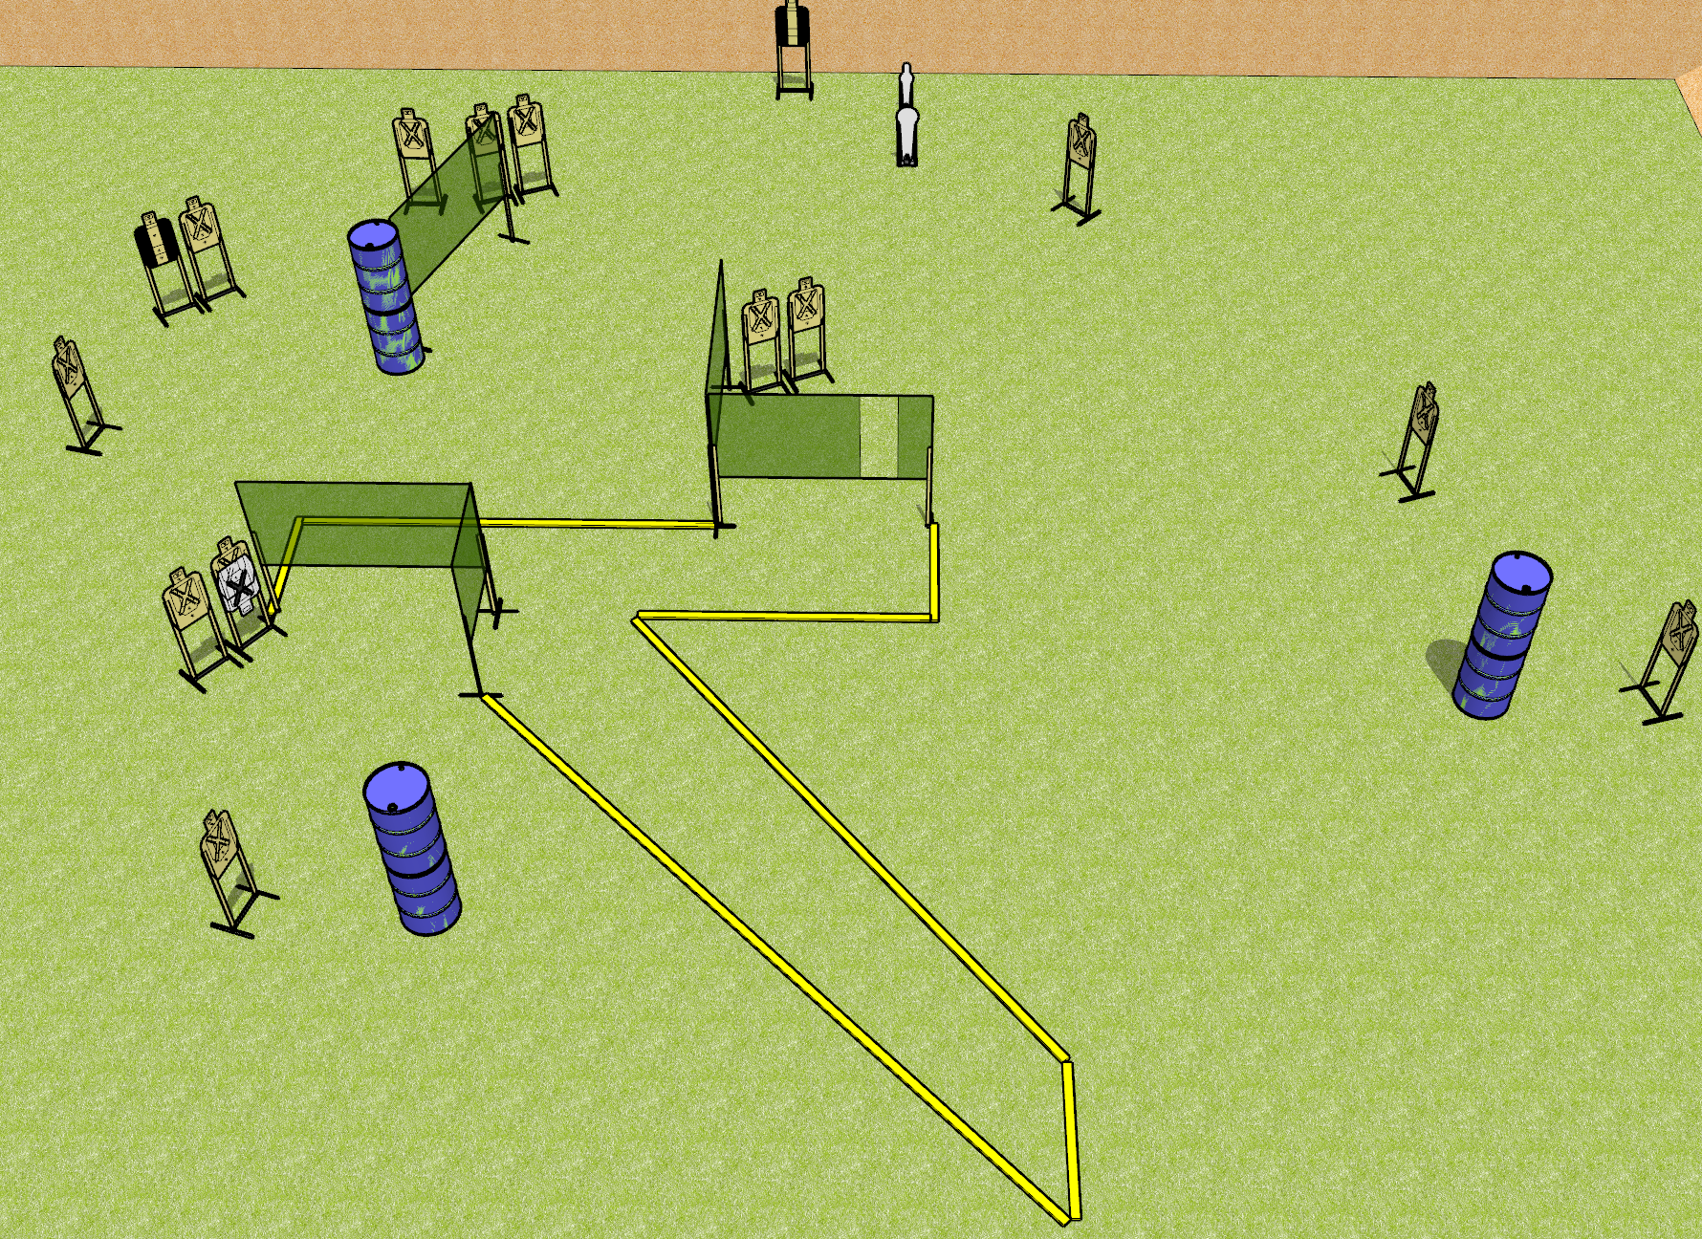
 | Dothan Gun Club – USPSA Match Nom Nom Course Designer : Drew Coleman
Round Count 32 Rounds 15 USPSA 1 mini, 1 colt popper
Equipment List 3 medium fault lines 3 8’ fault lines 8 wall feet 2 tuxedos

Slide 2
Nom Nom
Written Stage Briefing
Nom Nom is a 32 round, 160 point, Comstock course of fire. There are 15 USPSA targets, 1 colt popper, and 1 mini popper. The best 2 hits on paper will score, and steel must fall to score. The start signal is audible.
Handgun start position is anywhere inside the shooting area, wrists below belt. Handgun is loaded and holstered.
PCC start position is anywhere inside the shooting area, stock on belt. Carbine is loaded, held with both hands, safety on.
On start signal, engage targets as they become available from within the shooting area.

